Slide 1

Vehicles chasing each other around
a closed course with varying property

Slide 2

Outline
Company Description
Overall System Definition
Subsystem Details
Power and Cost Analysis
Conclusion
Future Plans
DUAYENLER

Slide 3
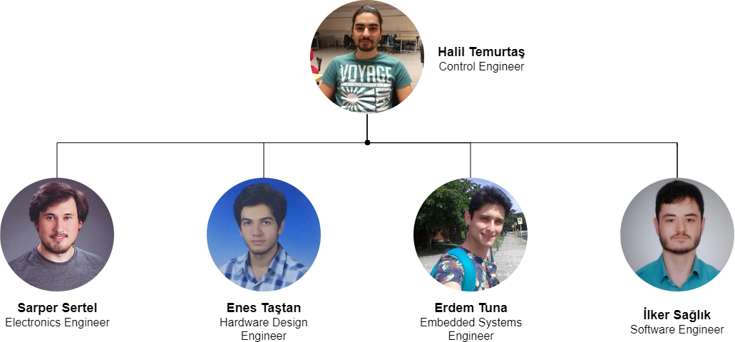
Team
DUAYENLER

Slide 4
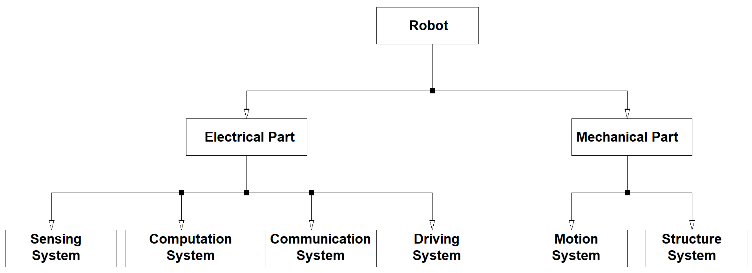
System Diagram
DUAYENLER

Slide 5
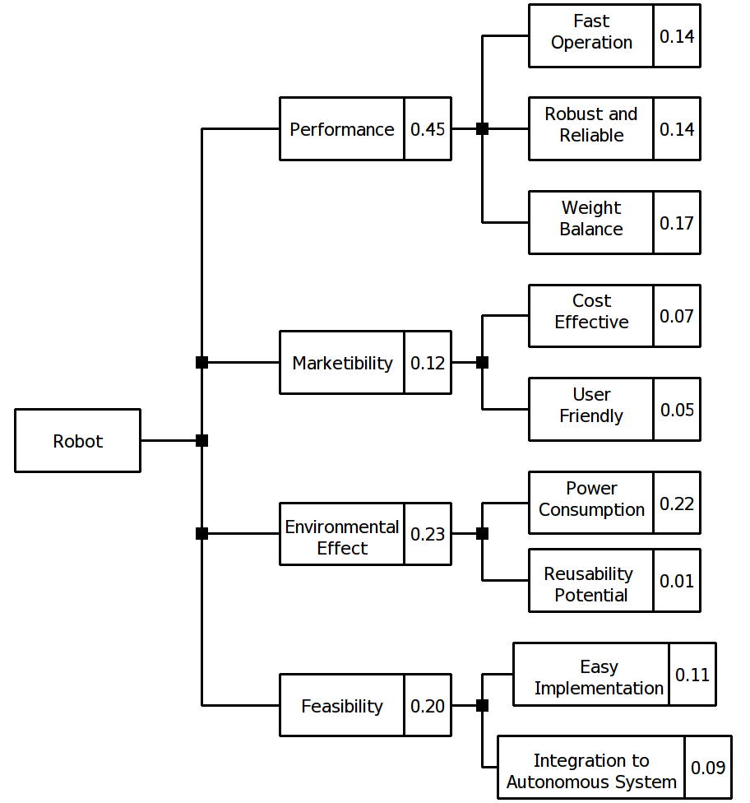
Objective Tree
DUAYENLER

Slide 6
Project Requirements
The vehicle should
detect the lane,
follow the lane,
detect the opponent and
communicate with the opponent.
DUAYENLER

Slide 7
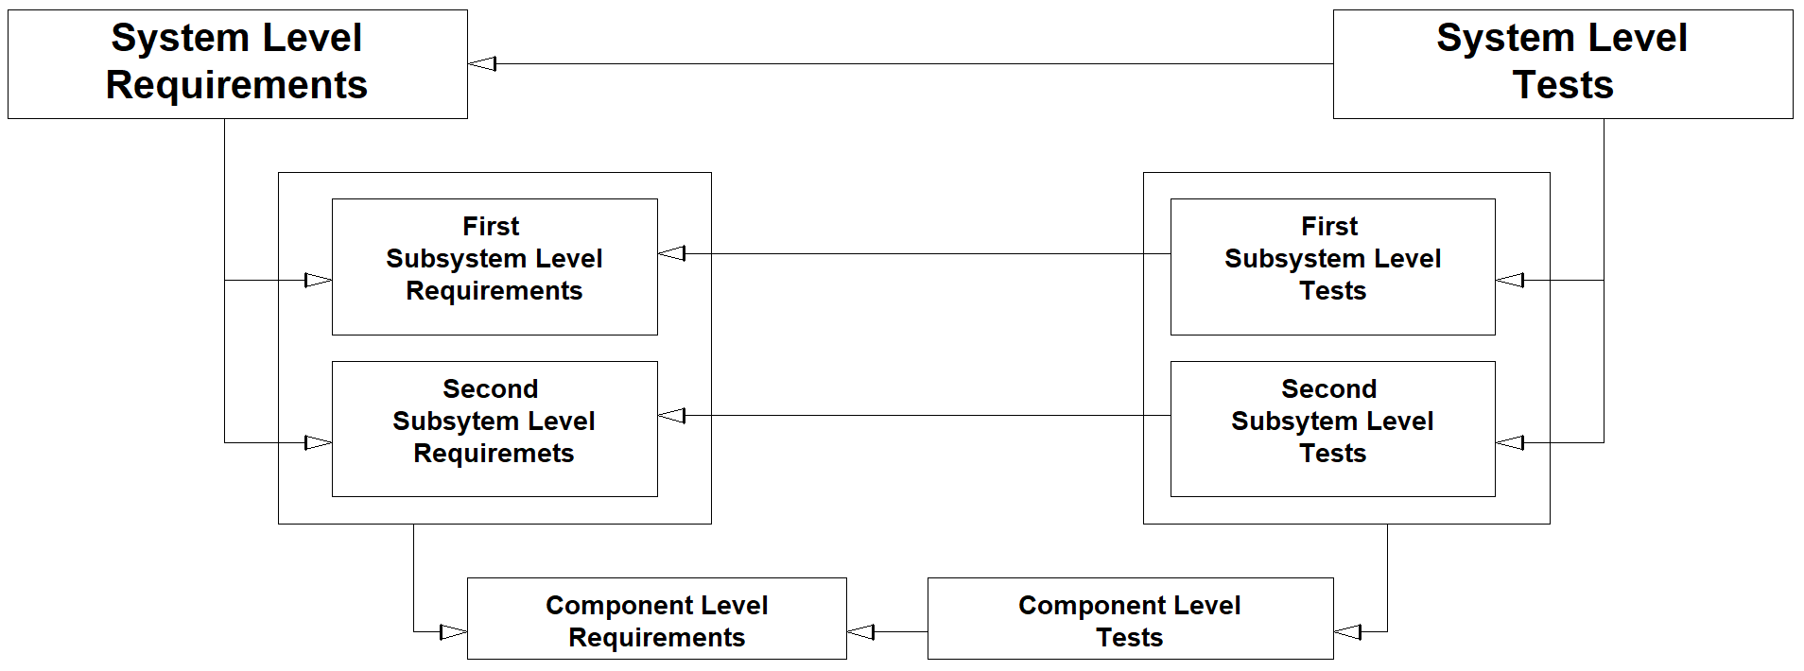
V-Model
DUAYENLER

Slide 8
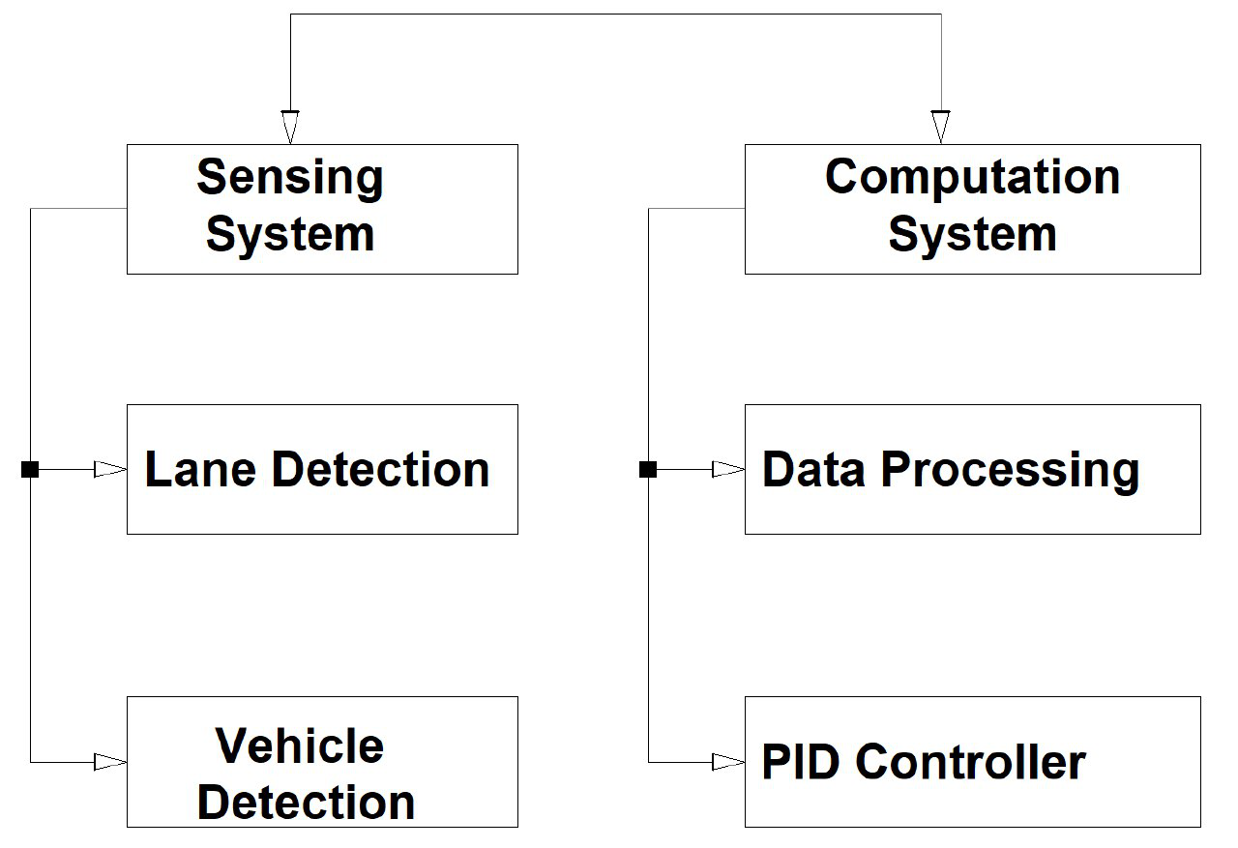
V-Model
DUAYENLER

Slide 9
Lane Detection Subsystem
Problem
Detecting lane lines out of a captured image in real time
DUAYENLER

Slide 10
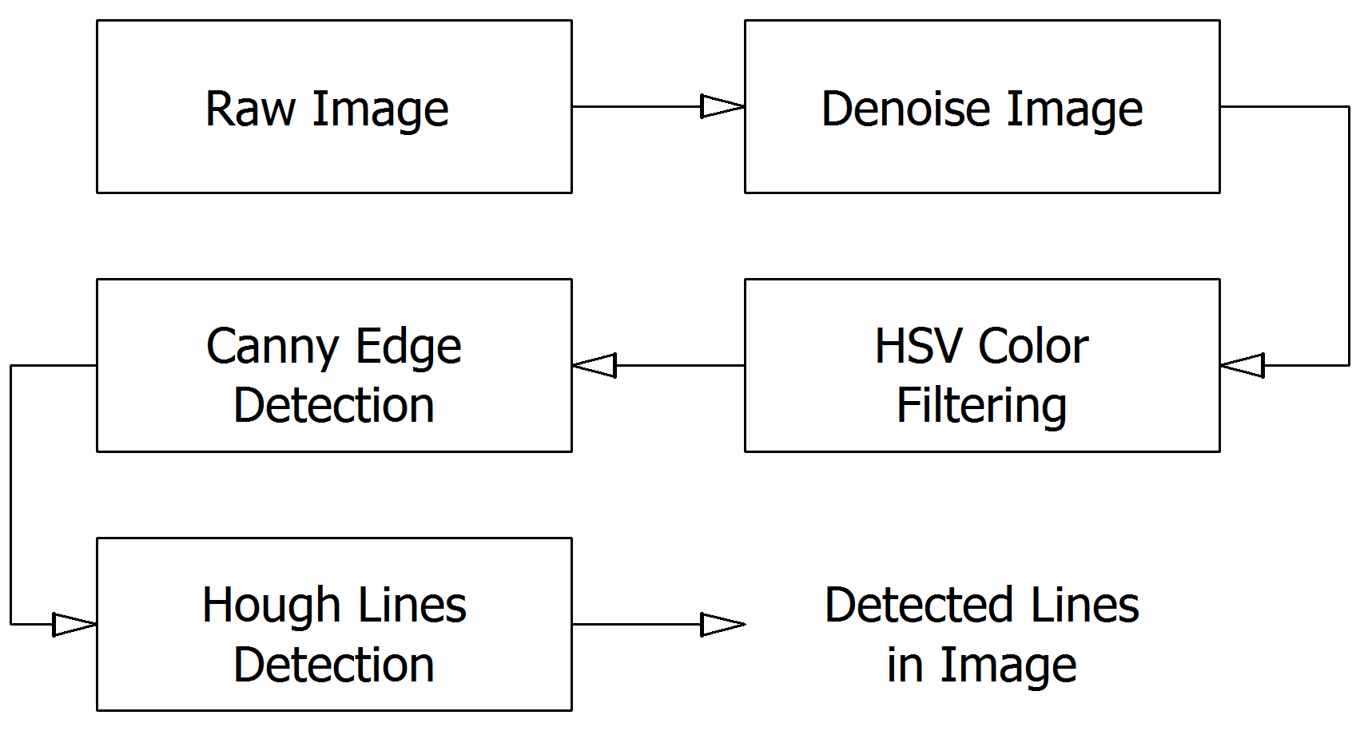
Lane Detection Subsystem
Solution
DUAYENLER

Slide 11
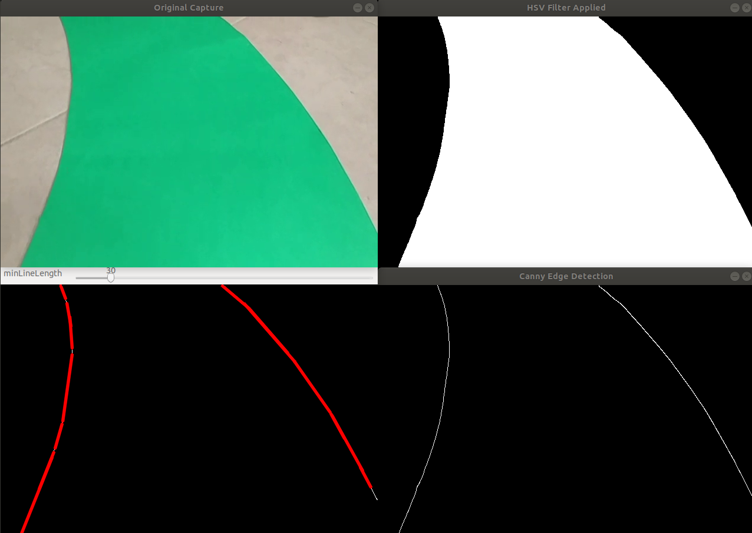
Lane Detection Subsystem
Sample Outputs of Color Filtering, Canny Edge Detection and Hough lines
DUAYENLER

Slide 12
Data Processing Subsystem
Problem
Determining the turn angle and direction out of the found lines in the image
DUAYENLER

Slide 13
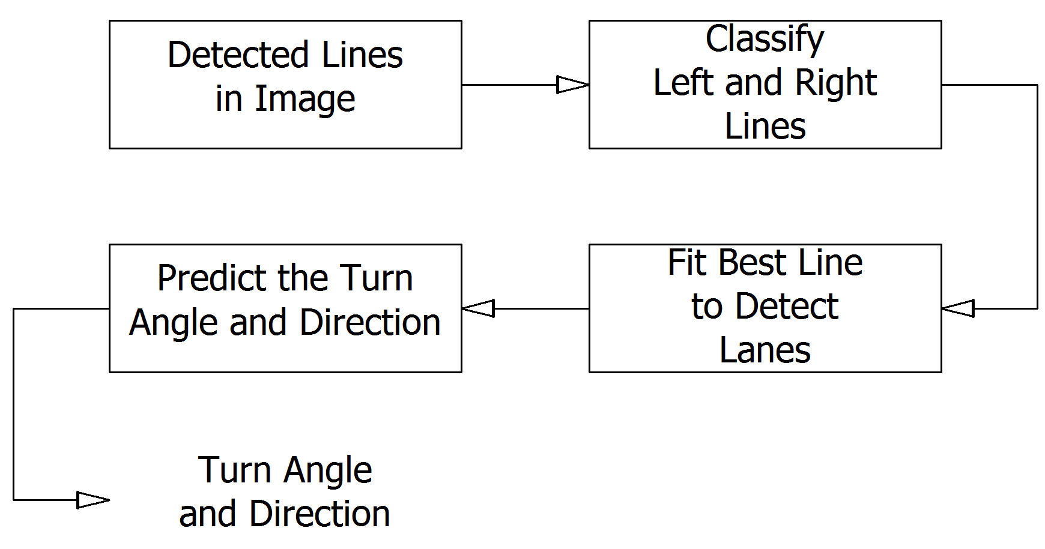
Data Processing Subsystem
Solution
DUAYENLER

Slide 14
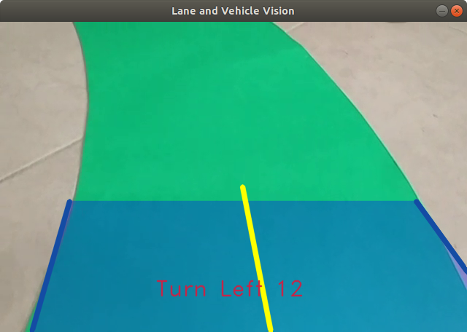
Data Processing Subsystem
Sample Output of Data Processing Subsystem
DUAYENLER

Slide 15
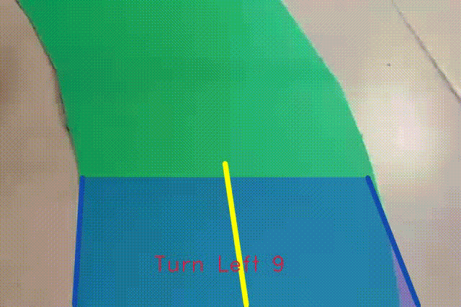
Lane Vision of the Vehicle
Sample Realtime Video Containing the Turn Angle and Direction
DUAYENLER

Slide 16

PID Controller Subsystem
Problem
Receiving data from processing unit
Following the path with acquired input
DUAYENLER

Slide 17
PID Controller Subsystem
Problem
Receiving data from processing unit
Serial communication of Rpi and Arduino
Following the path with acquired input
DUAYENLER

Slide 18
PID Controller Subsystem
Problem
Receiving data from processing unit
Serial communication of Rpi and Arduino
Following the path with acquired input
Differential drive
DUAYENLER

Slide 19
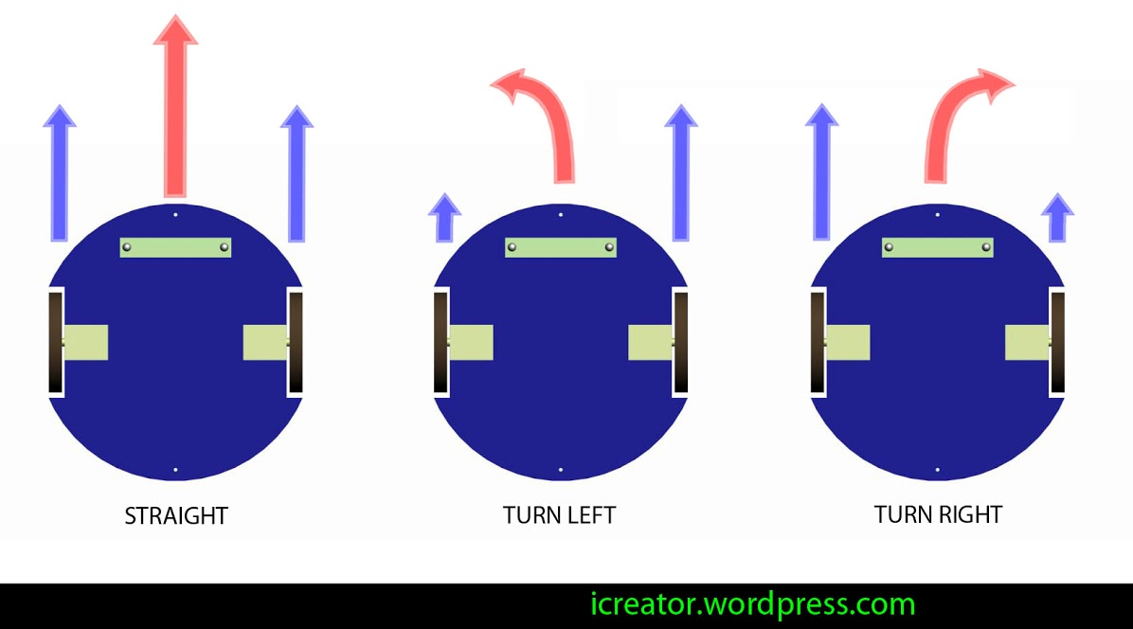
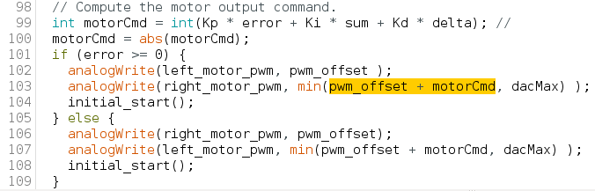
Differential drive
DUAYENLER

Slide 20
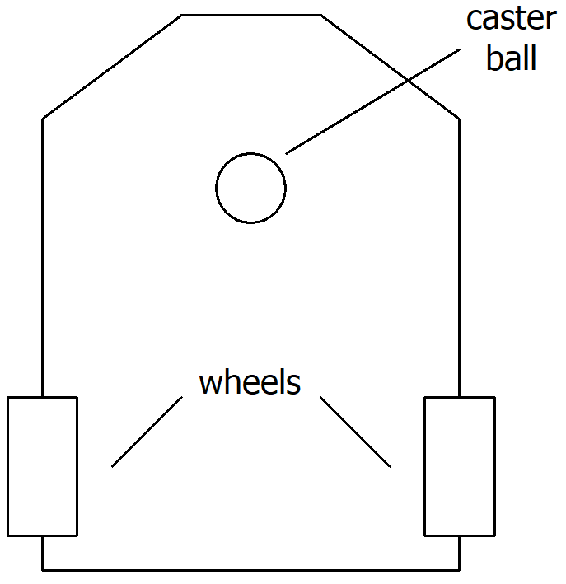
Structure System
Chassis structure
DUAYENLER

Slide 21
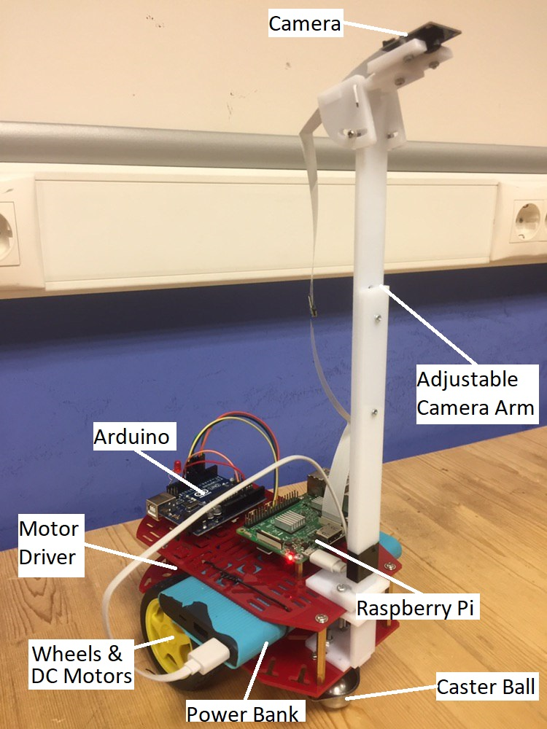
DUAYENLER

Slide 22
Vehicle Detection Subsystem
Problem
Detecting the opponent to be caught within 5cm range
Detecting the opponent if it reaches from back within 5cm
Giving meaningful data to Pi to trigger handshake protocol
DUAYENLER

Slide 23
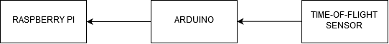
Vehicle Detection Subsystem
Main Solution
Two time-of-flight distance sensors at the front and back
DUAYENLER

Slide 24
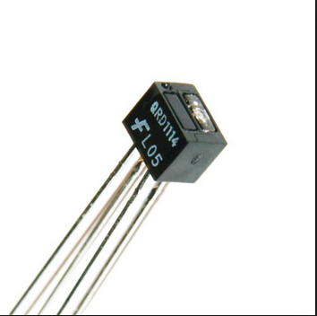
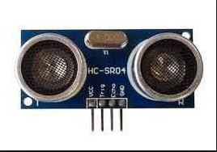
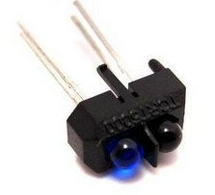
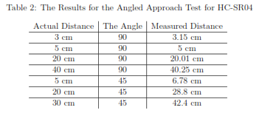
Vehicle Detection Subsystem (Tests)
DUAYENLER

Slide 25
External Communication Subsystem
Problem
Communicating with the opponent via Wi-Fi protocol
Executing handshake protocol
DUAYENLER

Slide 26
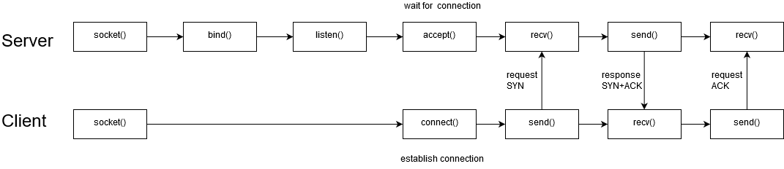
External Communication Subsystem
Main Solution
An algorithm utilizing network programming
DUAYENLER

Slide 27
External Communication Subsystem(Tests)
Raspberry Pi as Client Test
Raspberry Pi as Server Test
DUAYENLER

Slide 28
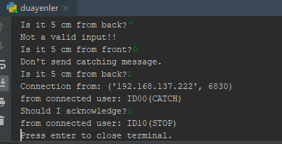
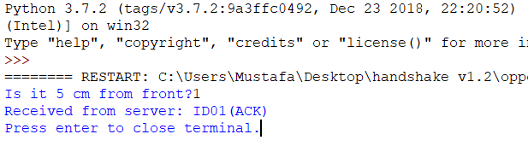
External Communication Subsystem(Results)
Duayenler as server:
Opponent as client:
DUAYENLER

Slide 29
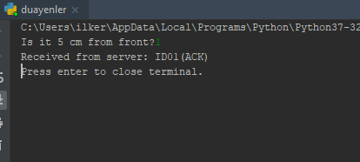
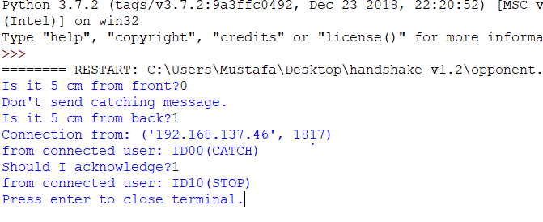
External Communication Subsystem(Results)
Duayenler as client:
Opponent as server:
DUAYENLER

Slide 30
Power consumption
 | Current (Avg) A | Watt(Avg) W | Current (Max) A | Watt(Max) W
Raspberry pi | 0,85 | 4,25 | 2,5 | 12,5
Arduino | 80m | 0,4 | 0,2 | 1
Driver and DC Motors | 1,5 | 18 | 3 | 36
ToF sensors | 19m | 62.7m | 40m | 132m
Total power consumption | 2,45 | 22,71 | 5,74 | 49,6
DUAYENLER

Slide 31
Cost Analysis
Component | Price ($)
Raspberry pi | 48
Arduino | 5
Driver and DC Motors | 24.5
ToF sensors | 18
Wheels | 8
Powerbank | 12
Li-po Battery | 15
Additional components | 10
Additional payment | 15
Camera | 23
Chassis | 20
Total Project | 198,5
DUAYENLER

Slide 32
Deliverables
Technical manuals
Elliptical path
Rechargeable battery and the charger
Flash drive
The vehicle will have two (2) years of warranty
DUAYENLER

Slide 33
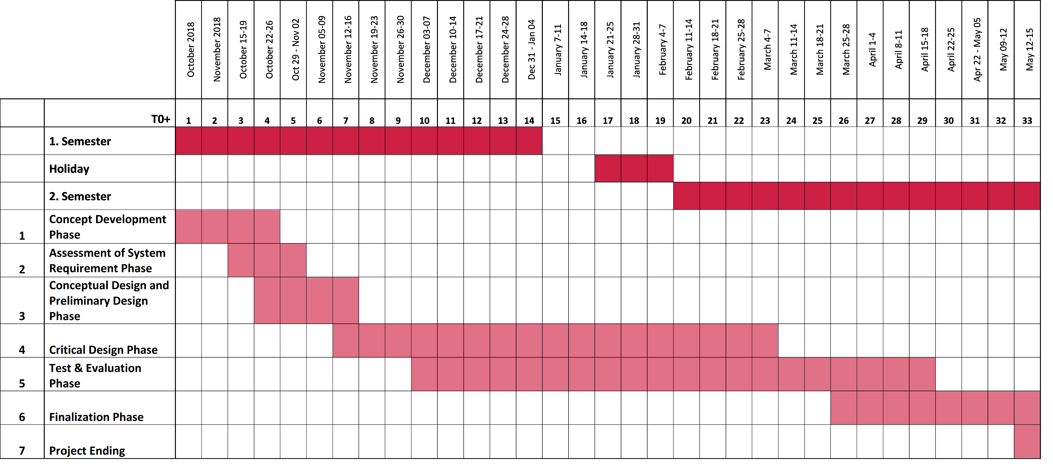
Gantt Chart
DUAYENLER

Slide 34
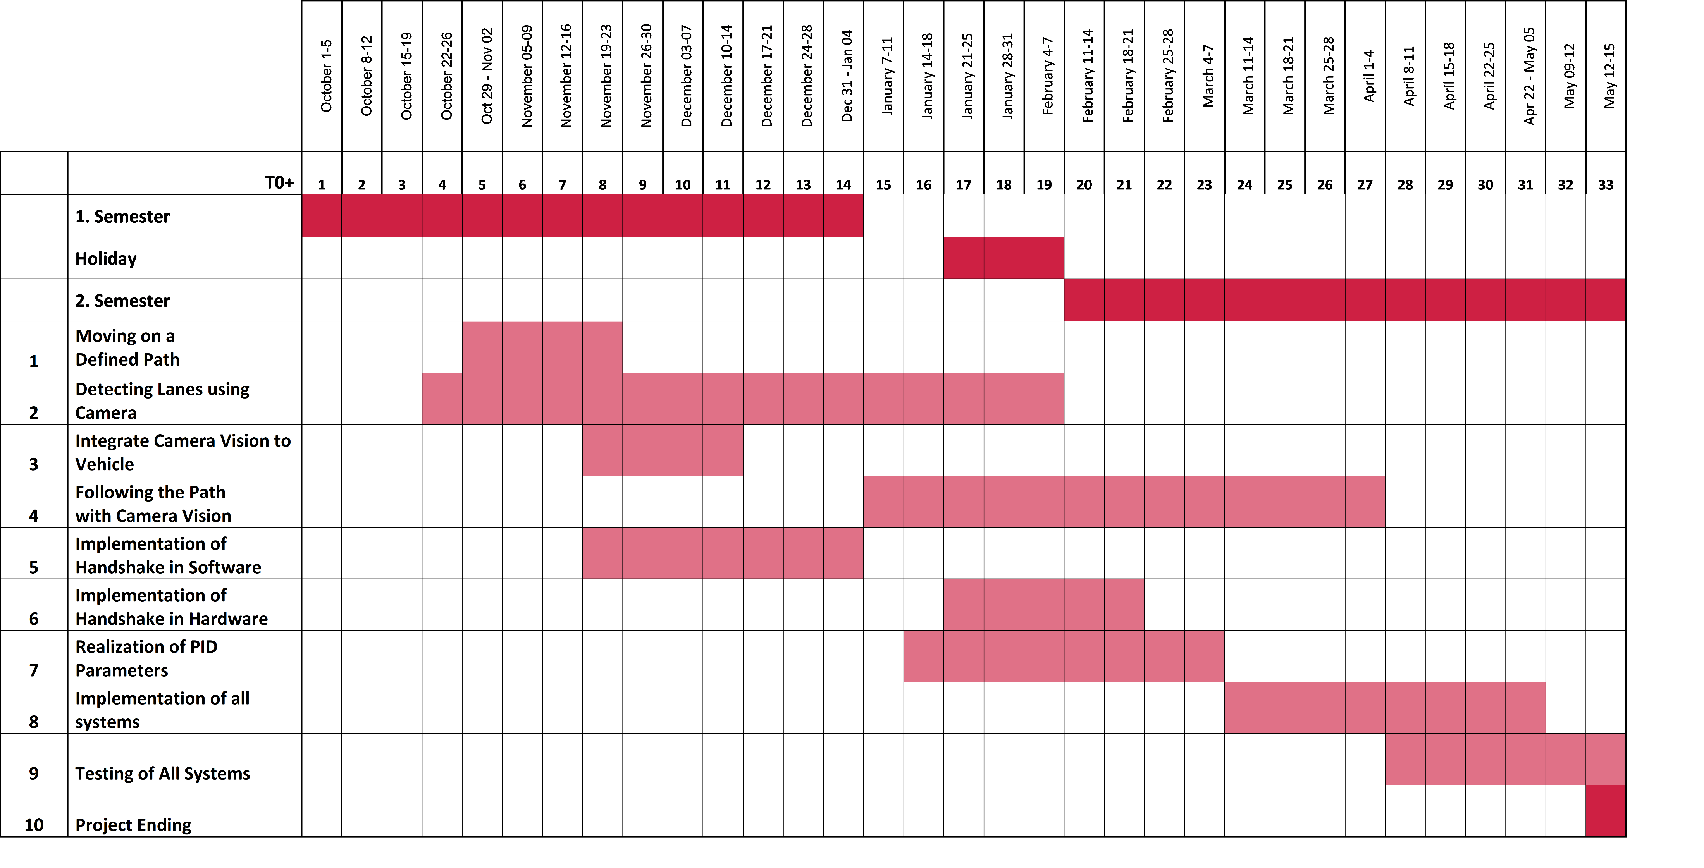
Milestones Chart
DUAYENLER

Slide 35
Conclusion
Our passion is your future
DUAYENLER

Slide 36
Thanks for your kind attention.
DUAYENLER

